Slide 1
Input device — Sensor

Slide 2
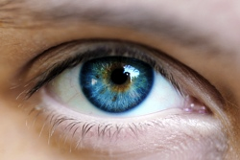
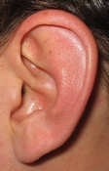
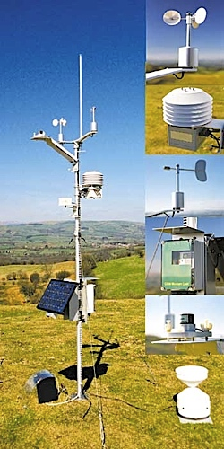
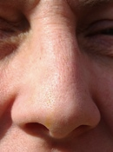
A normal PC has no senses, but we can give it some: We can connect sensors to it...
A sensor is a device that converts a real-world property (e.g. temperature) into data that a computer can process.

Slide 3
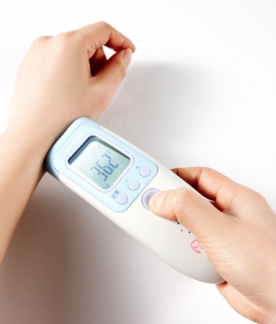
Temperature(温度) sensor
Electronic thermometers
(电子温度计)
Controlling heating systems in buildings, including greenhouses and chemical reaction

Slide 4
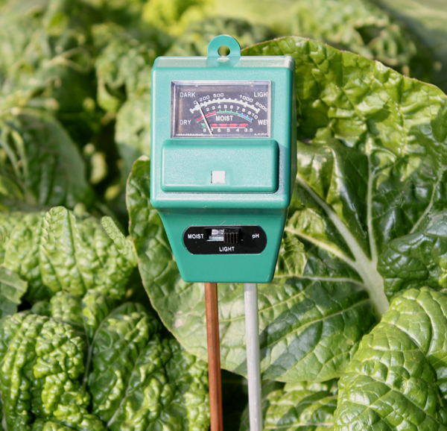
Humidity\moisture(湿度) sensor
A humidity sensor produces a signal that depends on the concentration of water vapor in the atmosphere.
e.g. : Greenhouse

Slide 5
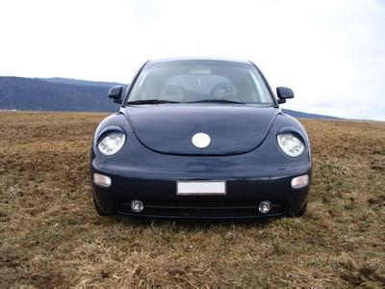
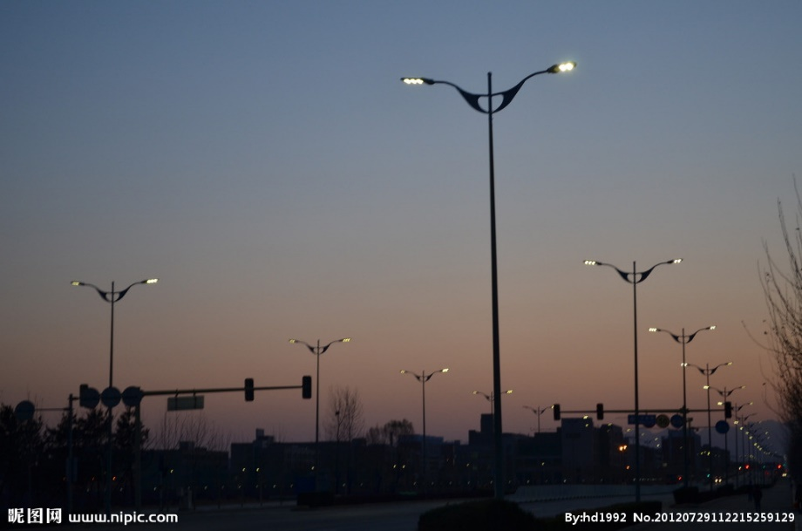
Light(灯光) sensor
A light sensor produces a signal that depends on the level of light falling on it.

Slide 6
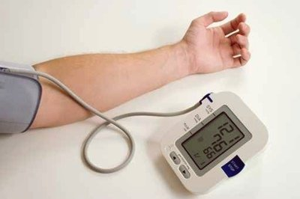
Pressure(压力) sensors
A pressure sensor produces a signal that depends on the pressure to which it is exposed.
Upper 90-130 lower 60-90
e.g. : An automatic blood pressure monitor
(自动血压监护器)

Slide 7
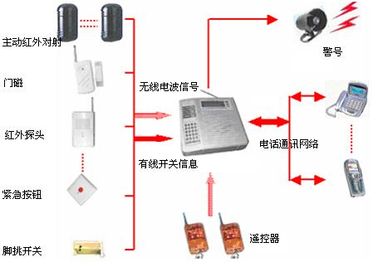
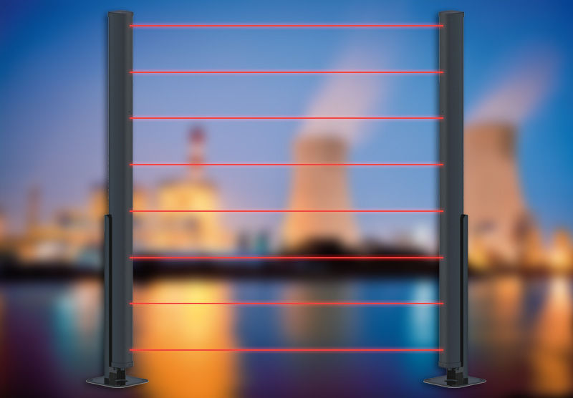
Infrared(红外线) sensor
An infrared(IR) sensor produces a signal that depends on the level of IR falling on it.
e.g. : Detecting intruders (监测入侵者)

Slide 8
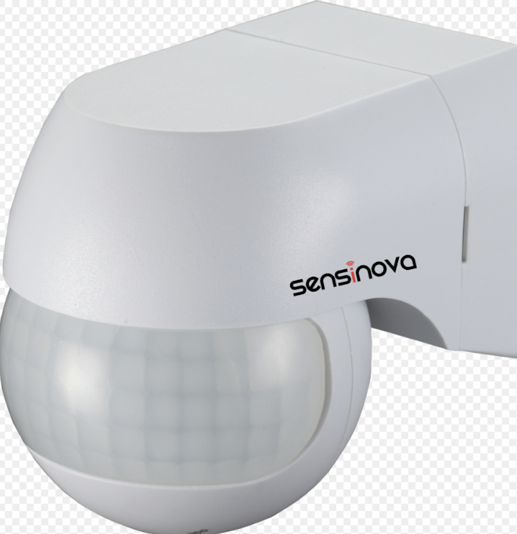
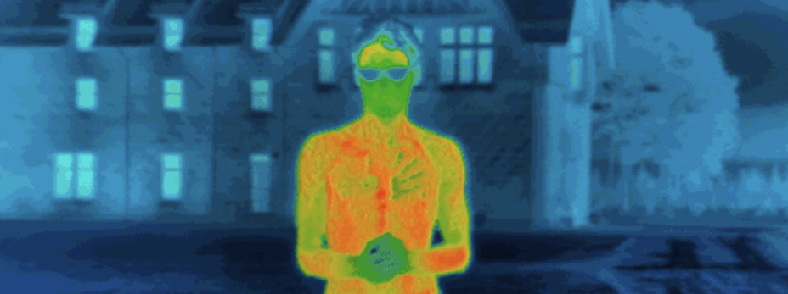
Infrared(红外线) sensor
An infrared(IR) sensor produces a signal that depends on the level of IR radiation falling on it.

Slide 9
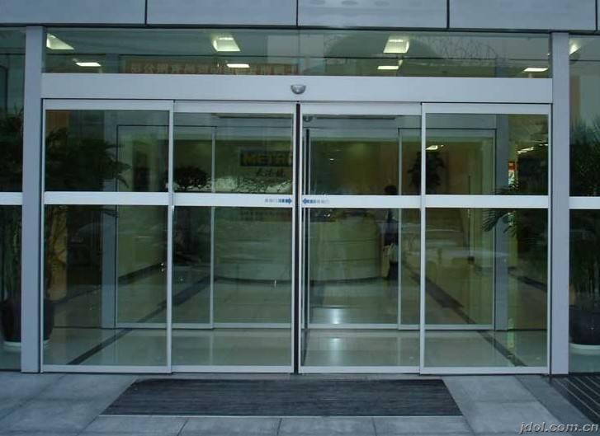
Proximity (距离) sensor
e.g. : Operating automatic doors

Slide 10
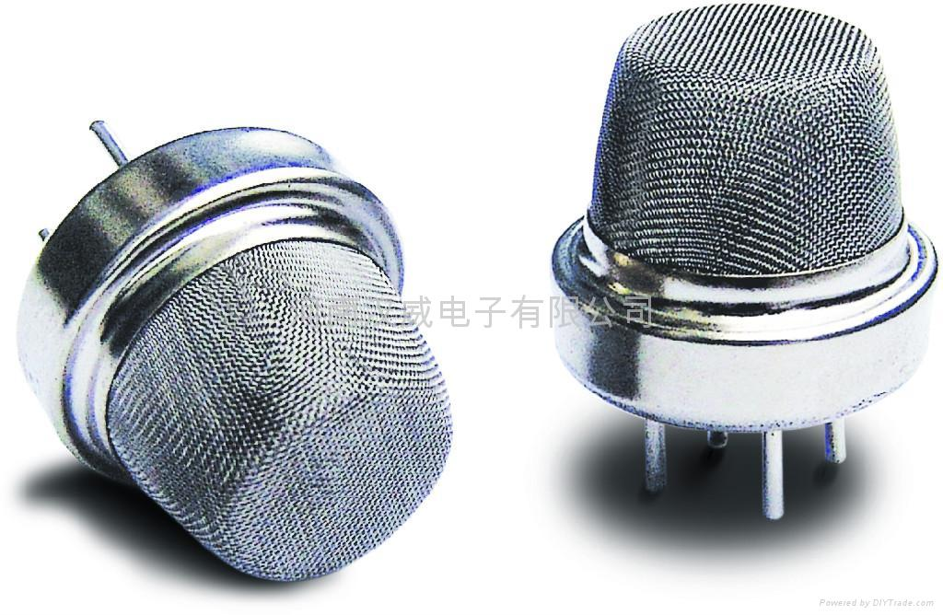
Gas sensor
A gas sensor produces a signal depending on the concentration of a particular gas.
An LPG(液态丙烷气体) sensor
e.g.：Environmental monitoring(环境监测)

Slide 11
Examples of sensors and the properties they detect are.
Sensor What it Detects
Temperature Temperature
Light Light / dark
Pressure Pressure (e.g. someone standing on it)
Moisture Dampness / dryness
Water-level How full / empty a container is
Motion Movement nearby
Proximity How close / far something is

Slide 12
Application use sensors
Sensor type | Possible applications
Temperature
Control a central heating systems
Control the temperature in a greenhouse
Infra-red
Detecting an intruder by the breaking of an infra red beam
Pressure
Detecting intruders in a burglar alarm system
Counting vehicles as they pass over a bridge
Monitoring the light levels in a greenhouse
Automatic doors to detect the presence of a person
Light
Motion
Detecting movement(as in virtual reality interface devices)
Oxygen
Environment monitoring (measuring the oxygen content in a river to check for pollution)
Moisture/
humidity
Monitoring a greenhouse environment
Monitor dampness levels in an industrial application
PH
Used to measure acid/alkaline levels in a river(pollution monitoring)
Acoustic/sound sensor
Picking up sounds (used in a burglar alarm system)

Slide 13
EXAMPLE 1 —— monitoring a burglar(窃贼) alarm system
Gather data from sensors (infra-red, motion) in the house
Signal are sent to an ADC where they are converted into digital
The digital information is then sent to the computer
The computer compares this information with pre-set data
If it is out of range (example, pressure too high, beam has been broken, etc) then a signal is sent to sound an alarm
Alarm continues to sound until system is re-set
System continues to monitor sensors until turned off

Slide 14
EXAMPLE 1 —— monitoring a burglar(窃贼) alarm system
Give the flowchart of the processes described in the last slide.

Slide 15
Monitoring a burglar alarm system
Sensor read data
ADC
Computer read data
no
yes
Out of range?
yes
Monitoring?
DAC
no
Warns operators
End
no
yes
Re-set?

Slide 16
EXAMPLE 2 —— control a chemical process
Gather data from sensors(temperature, pressure) from the reactor vessel (反应槽)
Signals are sent to an ADC where they are converted into digital
The digital information is then sent to the computer
The computer compares this information with pre-set data
if temperature<80º , a signal is sent to an actuator（致动器） to switch on the heater
If pressure < 2 Pa, a signal is sent to an actuator to open the valve.
DAC is used to convert signals to analogue to control heater and valves.
This continues until the chemical process is completed.

Slide 17
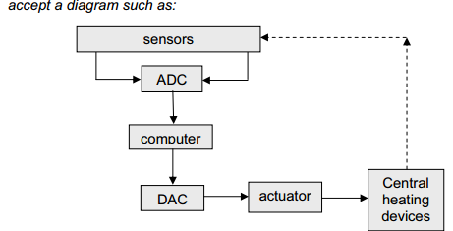
EXAMPLE 3 --central heating system

Slide 18
Why do we use sensors?
it is safer (even though humans can work in shifts there is always the danger of missing information at shift handover etc.)
Computers can run 24 hours a day, 365 days a year. (faster response to non-standard conditions and they don’t get tired)
computers are more accurate and can take more frequent readings (e.g. if readings need to be taken every 30 seconds, humans can make mistakes or miss readings or even find it is impossible to take readings at a short time intervals)
data can be automatically displayed and analysed without the need to enter data manually (which in itself could introduce errors into the system)

Slide 19
1. Name a suitable sensor for each of the following applications. Choose a different sensor in each application.
(i) central heating system
(ii) automatic doors
(iii) detection of intruders
(iv) greenhouse monitoring

Slide 20
1. Name a suitable sensor for each of the following applications. Choose a different sensor in each application.
(i) central heating system
– temperature sensor
(ii) automatic doors
– pressure sensor/pad
– light sensor
– infra red sensor
(iii) detection of intruders
– pressure sensor/pad
– light sensor
– infra red sensor
– sound sensor
(iv) greenhouse monitoring
– temperature sensor
– moisture/humidity sensor
– light sensor
– pH sensor
– CO2/O2 (levels) sensor

Slide 21
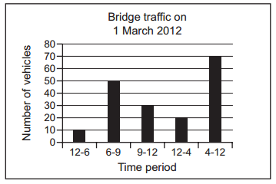
2. Vehicles passing over a bridge are detected automatically using sensors and a computer.
(a)What sensors could be used?
infra-red sensor
pressure sensor
(b) The graph below shows the number of vehicles counted during certain periods of the day. This graph is produced automatically at the end of each day. A record is created each time a vehicle is detected. These records are processed to generate the graph and for other purposes. What data need to be stored in each record?
Time when the car passes

Slide 22
(c) State two other methods of automatic data capture. In each case, name an application which would use this method.
1 mark for name + 1 mark for correct application
Barcode reader
e.g. – stock taking in supermarket
– getting prices at POS
– library system
RFID
e.g. – identifying/tracking individual items (livestock, vehicles, people)
Biometrics
e.g. – finger printing, face images, etc. as security systems
Magnetic stripe
e.g. – security cards (e.g. hotel room keys)
– credit/debit cards/ATMs/banking
OCR/OMR
e.g. – scanning in documents/photos/exam papers
Microphones
e.g. – interface (input) to a computer (used by disabled people)

Slide 23
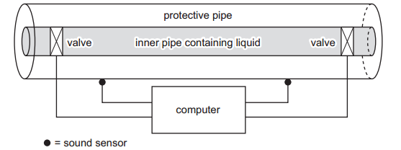
3. (a) Describe how the sensors, actuators, valves and computer are used to monitor and control the liquid in the pipe.
Any five points from:
– sensors send information to the computer
– converted to a digital signal by an ADC
– data compared to stored data (sound level) in computer memory
– if it is identified as a drip in the outer pipe ......
– ...... a signal is sent out by the computer (to the actuators)
– use of DAC to convert signal to analogue
– actuator/motor used to close valve in the inner pipe
– message sent to screen in control room/alarm sounds

Slide 24
(b) Give two advantages of using this computer-controlled system rather than visual checks by the workforce(工作人员).
Any two points from:
– computer response is much faster than a human
– 24/7 monitoring is possible/no breaks taken
– a human may miss “signs of leakage”/computer doesn’t get tired
– no/removes human errors (therefore safer)
– automatic graph/generation of a spreadsheet

